Slide 1
Chapter 3
Motion and Acceleration

Slide 2
3.1 Describing Motion
Every day you see objects and people in motion
Cars on the highway, students walking down the hallway
How do you describe the motion of these people and objects
You can say something is moving fast or slow
But you might need to know the speed of an object, as well as the direction it is moving

Slide 3
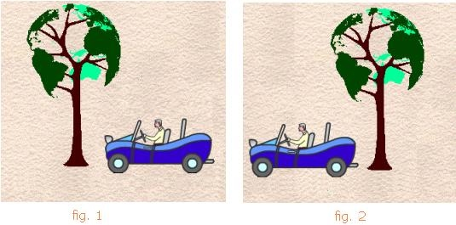
3.1 Describing Motion
Motion is the state in which one object’s distance from another is changing based on a reference point
A reference point is a place or object used for comparison to determine if something is in motion
We use a reference point to judge if motion occurred

Slide 4
3.1 Describing Motion
An object is in motion only when its position or distance is changing
So this means there is a difference between the total length between two points traveled and how far an object is from its starting position
Distance is the total length between two points traveled
Displacement is a vector that refers to how far out of place an object is; how far an object is from its starting point
Vector = a physical quantity that is specified by both size and direction (Ex: 100 km North)

Slide 5
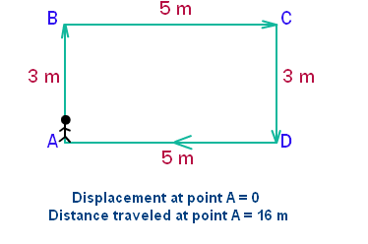
3.1 Describing Motion

Slide 6
3.1 Describing Motion
Examples
I walked 1 mile east to the movies then continued to walk ½ mile for ice cream in the same direction
Distance = __________________
Displacement = ___________________
After getting ice cream, I walked 1 mile west to my friend’s house.
Distance = __________________
Displacement = ___________________

Slide 7
3.1 Describing Motion
Now that we know how to determine if an object has moved and how far it is from its starting point, we can describe how fast something is moving
This is the speed
Speed is the measure of an object’s distance covered over an amount of time
In SI units, the unit of speed is usually meters per second (m/s) but can be in kilometers per hour (km/hr)

Slide 8
3.1 Describing Motion
Two types of speed
Instantaneous, meaning that is the speed at a single moment in time
Reading on a car speedometer
Average, which describes how quickly an object moved over the entire distance it traveled
This is what we typically use

Slide 9
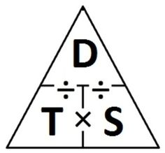
3.1 Describing Motion
$$Average speed (in\frac{m}{s}))= \frac{total distance (in meters)}{total time (in seconds)}$$
$$or= \frac{d}{t}$$
Example: What is the average speed of a car that travels a distance of 750 meters in 25 seconds?
d=
t=
s=?
d/t = 750 m/25 s = 30 m/s

Slide 10
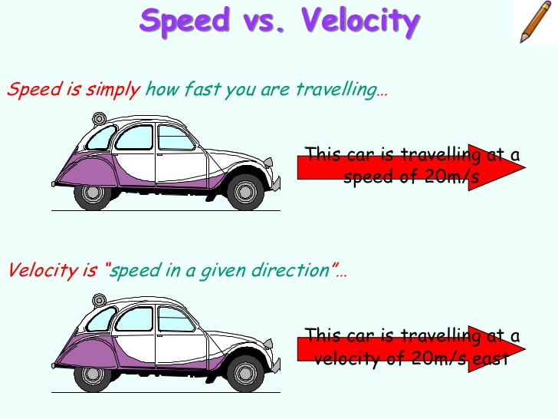
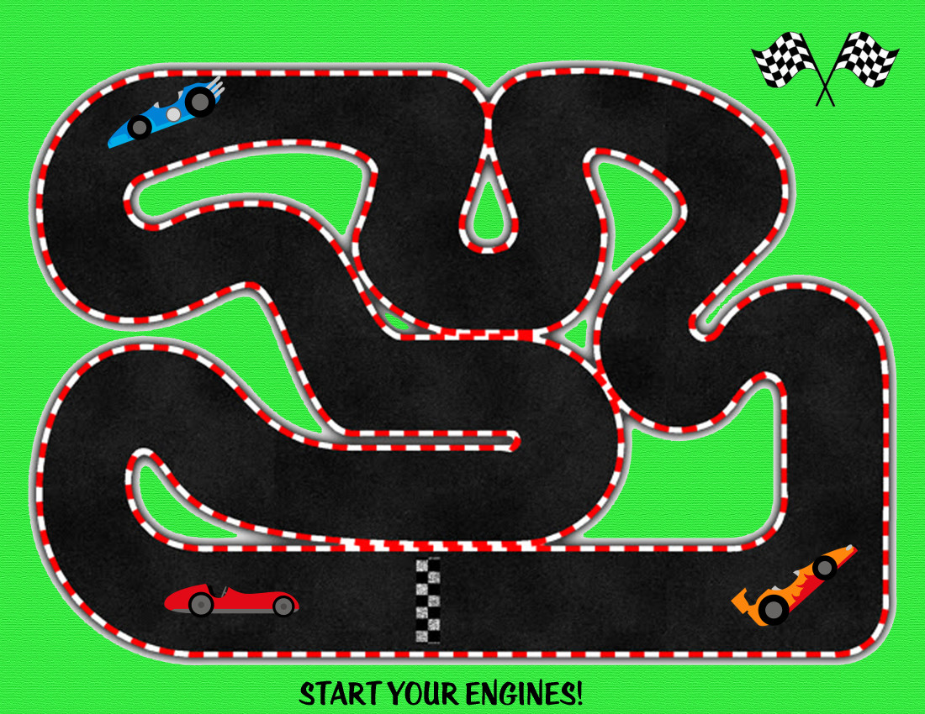
3.1 Describing Motion
Velocity
The velocity of an object is the speed of an object and its direction of motion
Objects have different velocities if they are moving at different speeds or in different directions
A racecar going around a track has a constant speed but a different velocity because its direction is changing
Think about people on up and down escalators…same speed, different directions, so their velocities are different
To summarize, a change of direction can result in a change in velocity even if the speed is constant

Slide 11
3.1 Describing Motion
Graphing Motion
The motion of an object over a period of time can be shown on a distance-time graph
Time is plotted on the X axis
Distance traveled is plotted on the Y axis
The slope of the line is the speed
Steep slope/line upward = fast speed/acceleration
Horizontal line/slope = object at rest
Downward line/slope = slowing down/coming to a stop

Slide 12
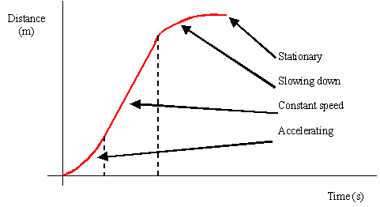
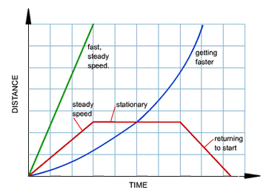
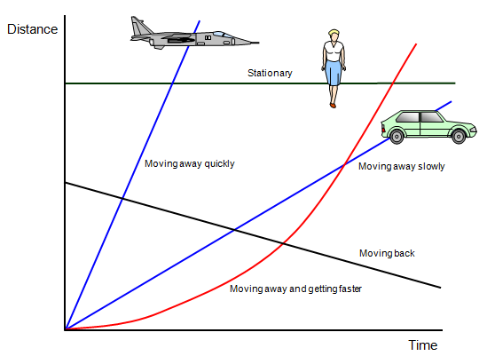
3.1 Describing Motion

